Slide 1
Normal Analytics
Software engineering project
SIANA DICHEVA, SAM THOMAS, William Tripp, Luo Zhao

Slide 2
Project Brief
.
For this project we are creating a web application for the use of personal tutors within the University in order for them to further support their students by having all relevant student information in a single, easy to navigate service.
At the moment, there is a lot of information available to tutors regarding each of their student's academic progress and attendance, but this information is formative and available in Blackboard, which is extremely hard to navigate and spread around through multiple pages.

Slide 3
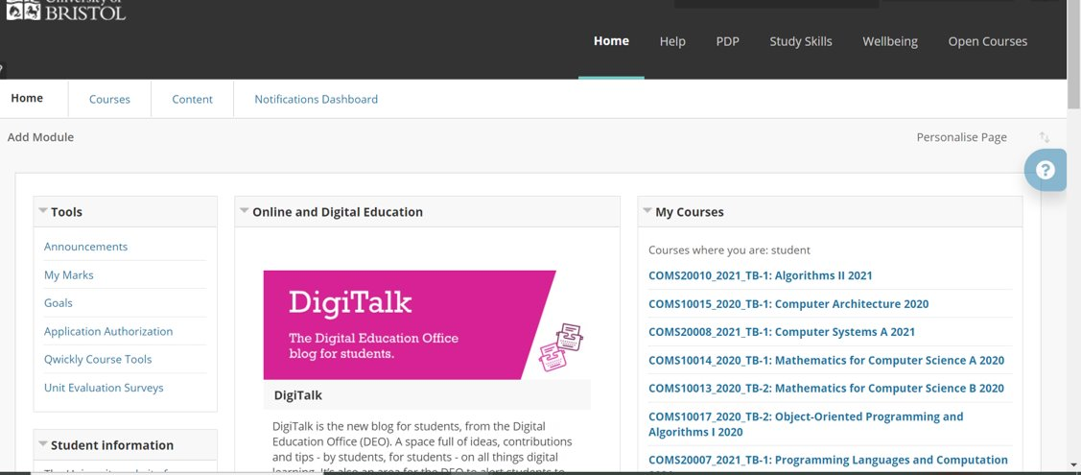

Slide 4
Opportunity
.
We were given this opportunity by Joel Ross, a Senior Lecturer at the Faculty of Engineering. Joel has told us he felt that he wanted to give more to support his students, but due to how spread out and time-consuming the information regarding each student is to find, he is not able to give feedback and support in as much depth as he would like, as regular as he would like.
He has been incredibly helpful during the process, forwarding us to different members of IT services and providing helpful feedback on our product during the different stages of developing(MVP,Beta).

Slide 5
Solution
Our solution to this problem is a web application using SpringBoot and React JS, deployed and accessible through IBM-Cloud, whereby with the APIs from the services previously mentioned, we will be able to get all of the information a tutor would require for a specific student and display it in an easy to navigate dashboard.
The tutor will be able to select a student and a group from a list of their specific students and be welcomed with a dashboard displaying a general overview of the student's academic progress throughout all units – including formative and summative assignments
From here, the tutor will be able to compare a student's result with the average result of the cohort in order to more easily identify areas that may require extra support, as well as the student's average overall grade as this is something that is not currently available to tutors.
There will be a page dedicated to students' attendance, displaying graphs specific to a unit or all of them with different filtering options.

Slide 6
Current State
In the current state of production, we have majority of the functionality implemented including log-in pages, which uses token-based authentication in order to access protected parts of our service, such as the dashboard. If successfully logged in, the tutor is then able to select a group of their students and a specific tutee they would like to access the dashboard of.
We had different versions of the dashboard, which we adapted to the changes, suggested by our client.
We have a multiple page working dashboard with various options, designed to help the tutor the most.
All parts of the frontend are connected to a SpringBoot server, which is secured and connected to MariaDB through IBM-Cloud, where all of the data is stored.

Slide 7
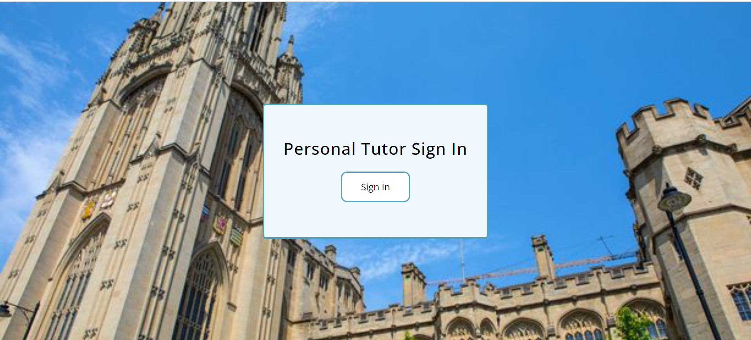

Slide 8
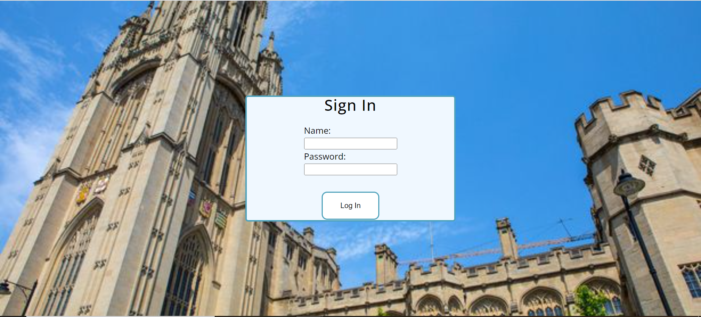

Slide 10
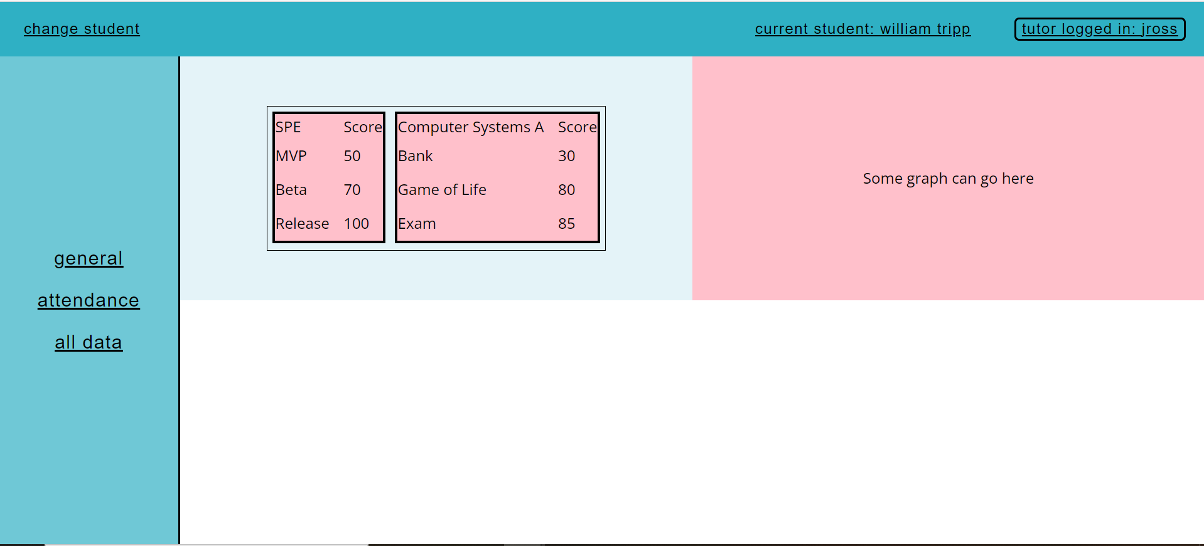

Slide 11
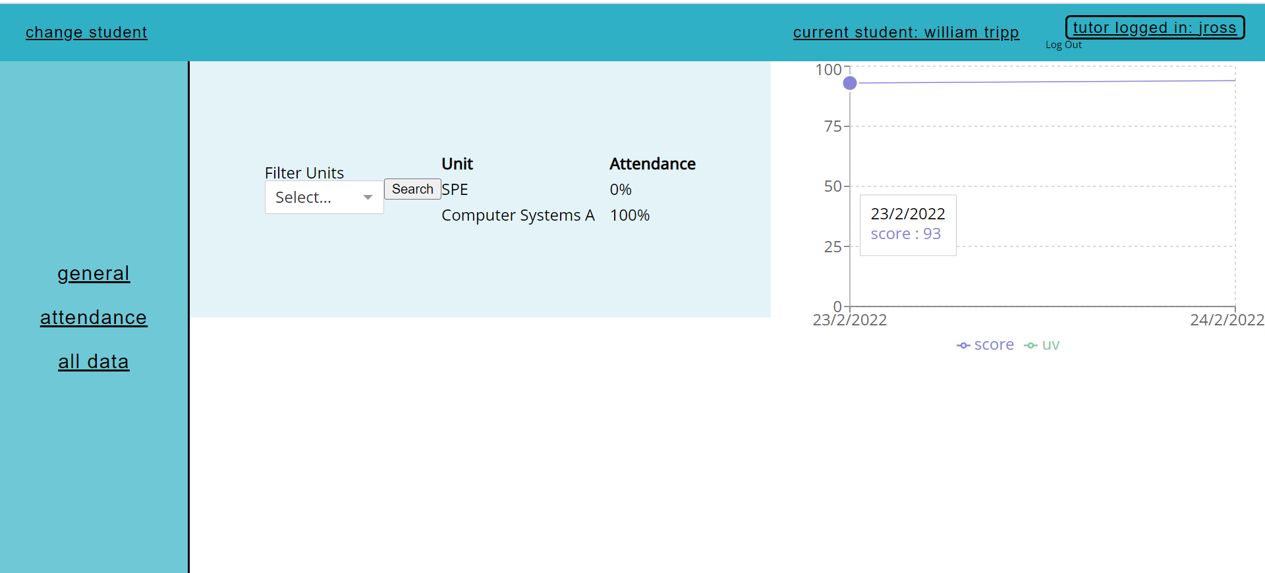

Slide 12
TB2 Plan
The main points of our TB2 plan were:
Connect backend to dashboard and login system
Dashboard design improvements
Implement Spring security
More extensive unit tests and integration testing

Slide 13
Plans for the Future
We plan to test the system thoroughly and finish the work on the design of the dashboard, adding more graph and perfecting the current design. We would arrange another meeting with our client before the deadline and possibly do user testing, which would be beneficial to get more insight what could be made better.
We will make a detailed documentation and an easy to follow instructions for use.

Slide 14
Biggest lessons learnt
We had different issues with connecting databases, deployment, testing and integration.
By resolving all these issues we deepened our general knowledge much more, as we were learning by trial-error and understood more how actual software developing happens and how interconnected everything is- for example, there is no frontend without the logic of the backend.
The lesson we learnt were that in software development things do not always go according to plan but with good organisation, communication and patience every matter could be resolved.

Slide 15
Thank you for listening.

